Slide 1
Pitch Protection Map
      A pitch protection map ensures that damage to the pitch caused by players and referees warming up before the match, during half-time and during the cooling down is limited by using the designated areas on the pitch. A pitch protection map contributes to:
      increase the quality of (natural grass) fields
      improve sports performance
      improve player satisfaction
      increase the usability of fields
      improve sports safety / reduce injuries due to the surface
      improve the image of Dutch football / football club
      increase the fan experience
      improve the appearance of the field during broadcasts
      Attached format can be adapted to the local situation and to the quality of the field at the specific moment.
      Use of the format leads to recognition and acceptance.

Slide 2
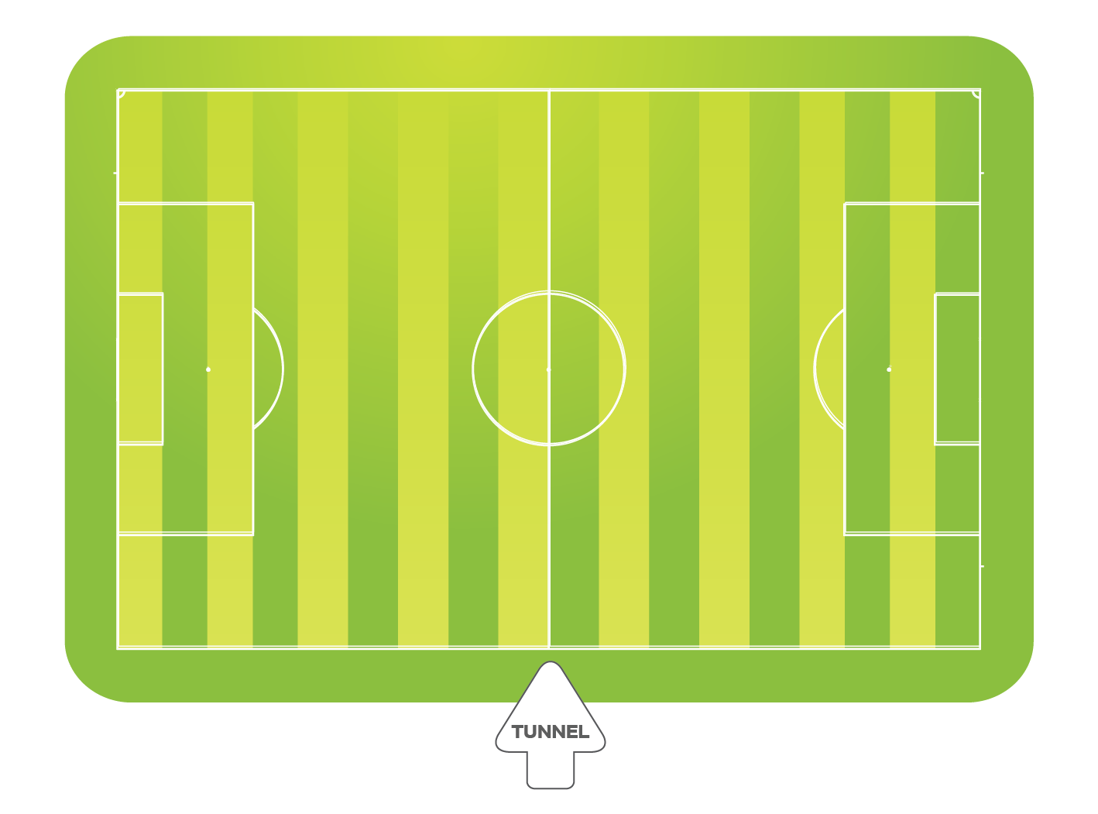
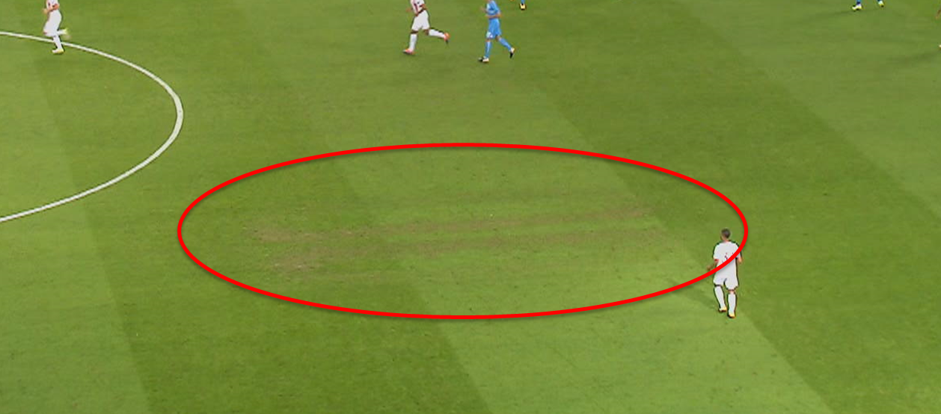
Warming-up
Fast feet
Fast feet
To protect the playing field during the match:
‘Fast feet’ training / intense warm-up on the artificial grass.
Use practice goals for the goalkeeper’s warm-up.
During rondos and positional play, please move cones after a few minutes.
The goalkeepers’ warm-up must take place in movable goals. In addition, depending on the condition of the field, the use of the goal area may be limited (for example, a maximum of 10 minutes) or not permitted at all.
GK warming-up
(mobile goals)
Warming-up
referees
GK warming-up
(mobile goals)
Fast feet
Fast feet
Warming-up
(Players are not allowed to follow each other in rows)
Warming-up
(Players are not allowed to follow each other in rows)
GK warming-up main goal
(max 10 min.)
      NO GO ZONE
Fast feet
Fast feet
Substitutes
(Rondo)
Substitutes
(Rondo)
      NO GO ZONE
Warming-up
Dug-out
Dug-out
Warming-up

Slide 3
During rest
To protect the playing field during the match:
‘Fast feet’ training / intense warm-up on the artificial grass.
Ideally in different and not all in the same area.
Extra irrigation takes place in the first/last minutes during half-time.
Repetitive
ball exercises
Repetitive
ball exercises
Fast feet
Fast feet
Warming-up
(Players are not allowed to follow each other in rows
Warming-up
(Players are not allowed to follow each other in rows
Fast feet
Fast feet
Warming-up
Dug-out
Dug-out
Warming-up

Slide 4
Cool-down
To protect the playing field:
The cool-down must not exceed 20 minutes, starting immediately after the final whistle.
Footballs and other training equipment are not permitted during the cool-down.
A cool-down must not take place in either penalty area.
      NO GO ZONE
      NO GO ZONE
Dug-out
Dug-out

Slide 5
tips
      Attach the pitch protection maps(s) in the following areas in A3 format:
      Dressing room of home club
      Dressing room of visiting club
      Referees' dressing room(s)
      "Personalise" the pitch protection map per match (enter the name of the visiting club)
      Hand over the pitch protection map(s) in A4 format to the following people before the warm-up:
      Team manager of home club
      Team manager of visiting club
It is useful to provide the team manager with multiple versions so that the team manager can distribute them to the people responsible for the warm-up within the club.
Ensure that the responsibility for keeping the pitch protection map up to date lies with multiple people (think of: field manager, facility manager, team manager, etc.).

